Slide 1
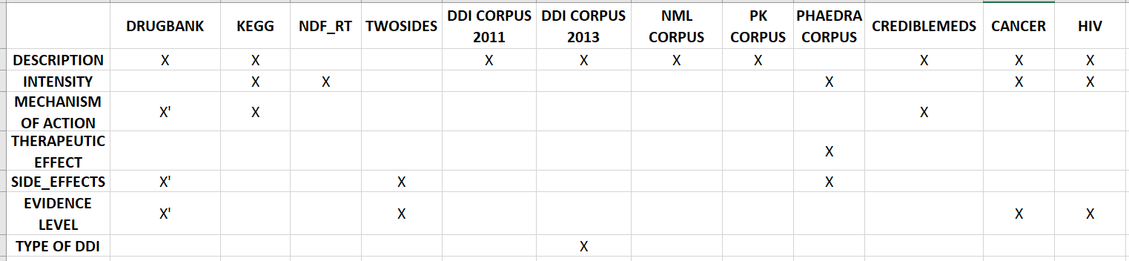
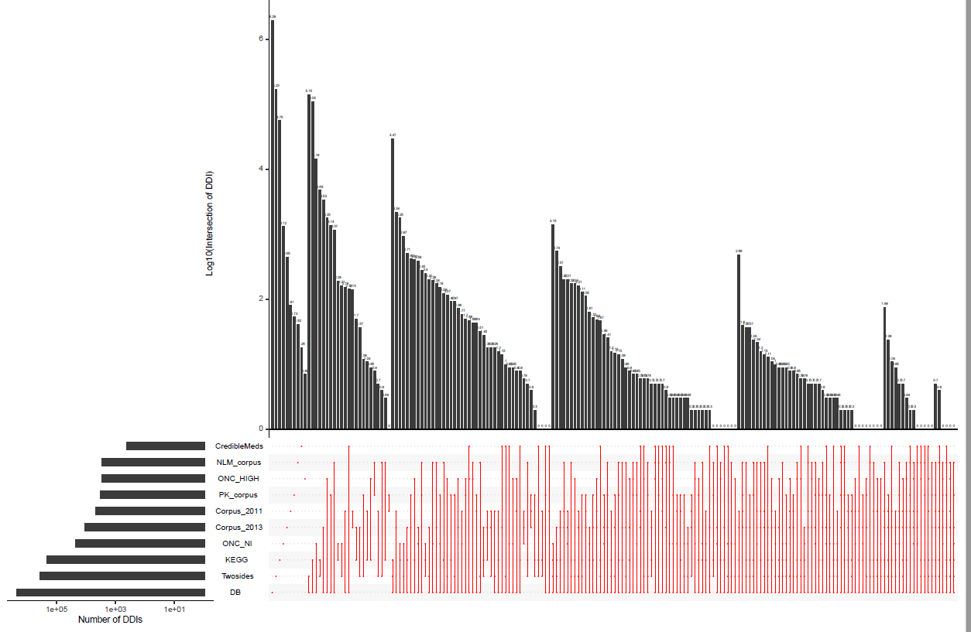
ELUCIDATING DRUG-DRUG INTERACTIONS UNDERLYING DRUG POLYPHARMACY PROFILES
Recollect DDIs information from public databases.
Treat and tidy data
What to do next -> Characterization
Information consistency
Frequency score
Drug ranking
Enrichment

